Slide 1
Project 3 feature selection & Classification
Joyce Lin, General assembly, data science immersive

Slide 2
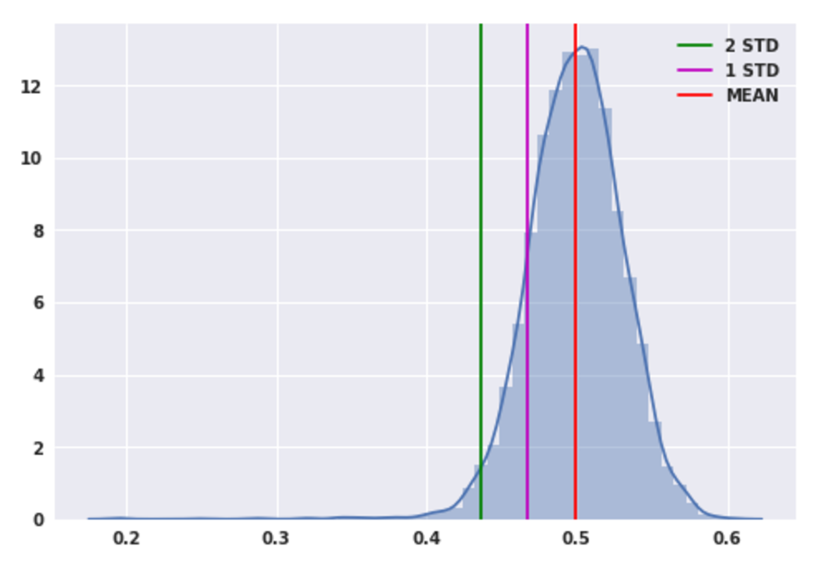
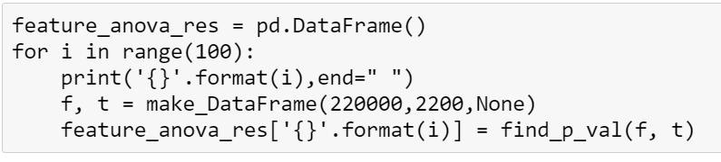
Procedure 1 Drop columns with anova (select K best) method
Create random selection on 1% of the data and feed to anova (f_classif) model
Iterate 100 times to get the average mean, min, max, standard deviation of p_value

Slide 3
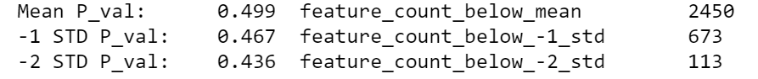
Procedure 1 Drop columns with anova (select K best) method
I simply dropped the 4000 top p_value features and kept the remaining 1000.
I intended to keep only 673 features which with p_value 1 standard deviation below the mean for further trial.
Then I picked the feature and target dataframe with ~5% of rows for later analysis

Slide 4

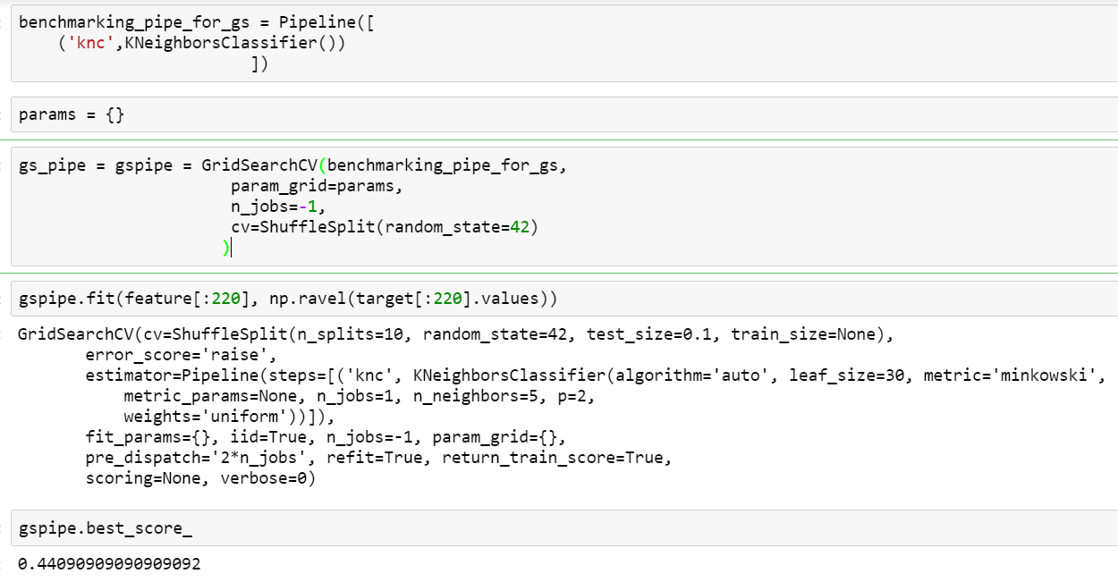
Procedure 1 Create Bench marking models
1. K Neighbor Classifier
2. Logistic Regression
ran with subset of
.1% of the data
.5% of the data
1% of the data
5% of the data
Pickled cv_results for each model

Slide 5
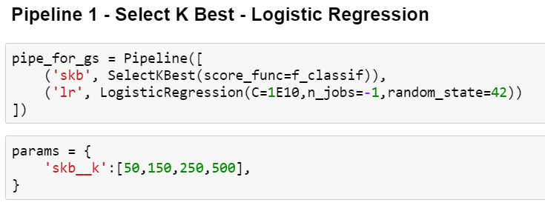
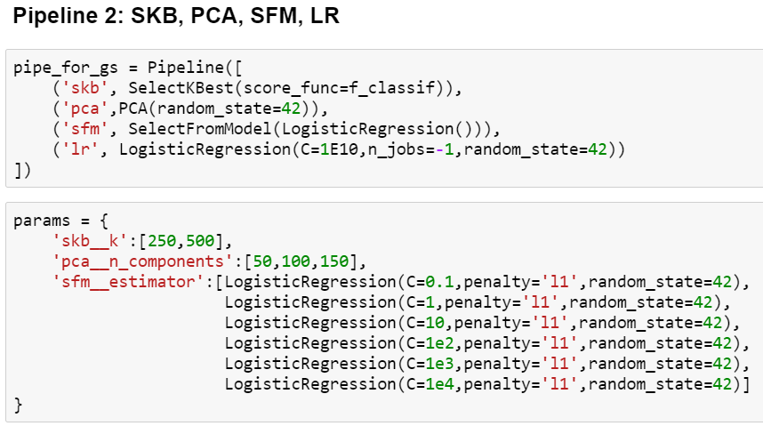
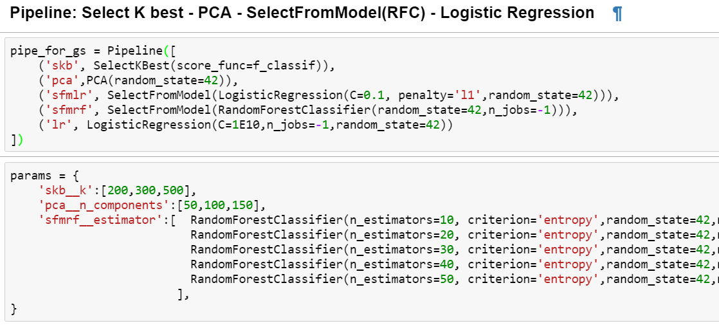
Procedure 2 Logistic regression Pipelines
ran with subset of
.1% of the data
.5% of the data
1% of the data
5% of the data
Pickled cv_results for each pipeline

Slide 6
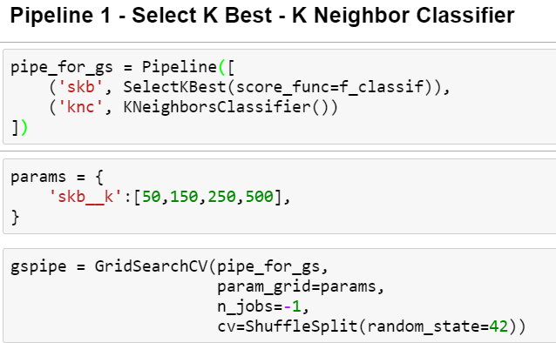
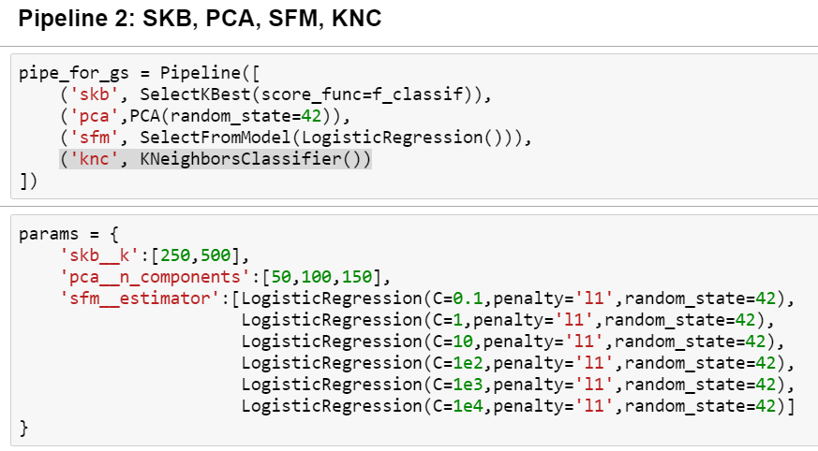
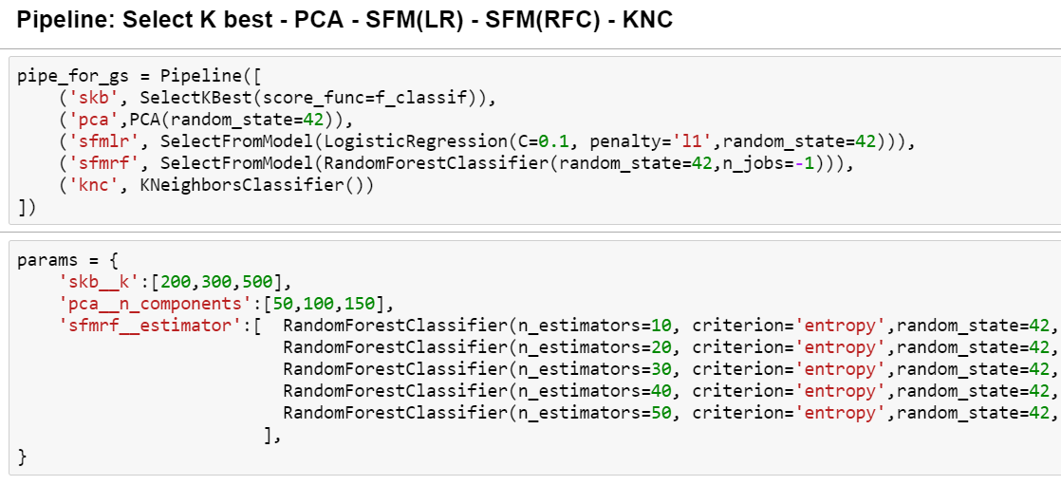
Procedure 2 K Neighbor classifier Pipelines
ran with subset of
.1% of the data
.5% of the data
1% of the data
5% of the data
Pickled cv_results for each pipeline

Slide 7
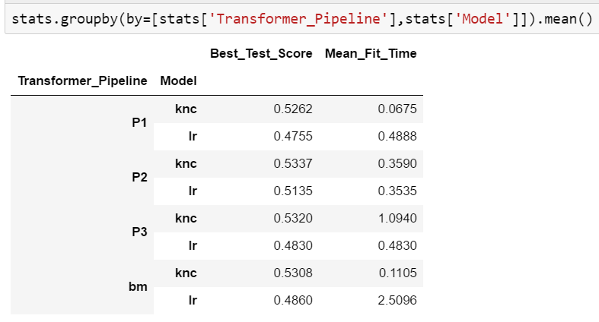
Procedure 2 evaluate each pipeline – test score
pipeline 2 KNC model has the highest average test score from all subset runs

Slide 8
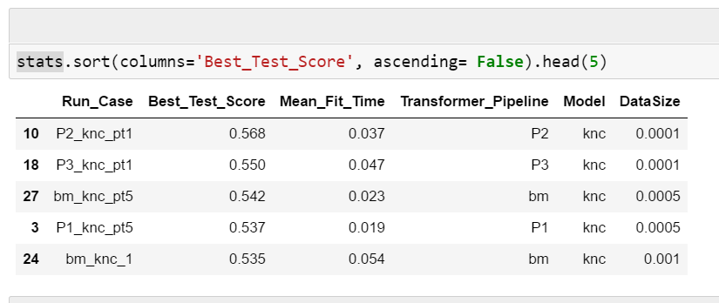
Procedure 2 evaluate each pipeline – test score
pipeline 2 KNC on .1% datasubset has the highest test score among all

Slide 9
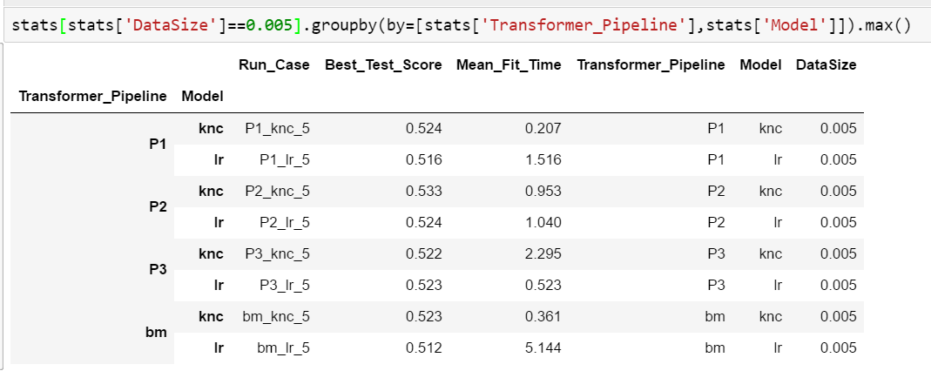
Procedure 2 evaluate each pipeline – test score
pipeline 2 KNC model has the highest test score among 5% data subset

Slide 10
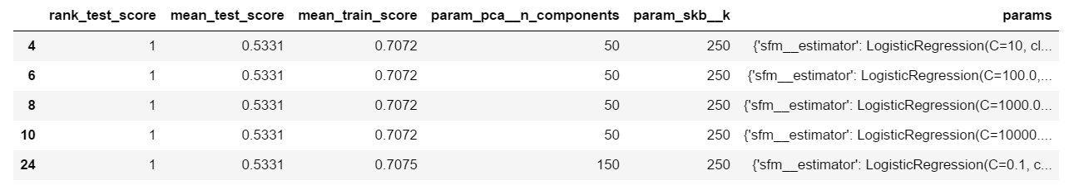
Procedure 2 evaluate each pipeline – test score
pipeline 2 KNC model has the highest test score among 5% data subset

Slide 11
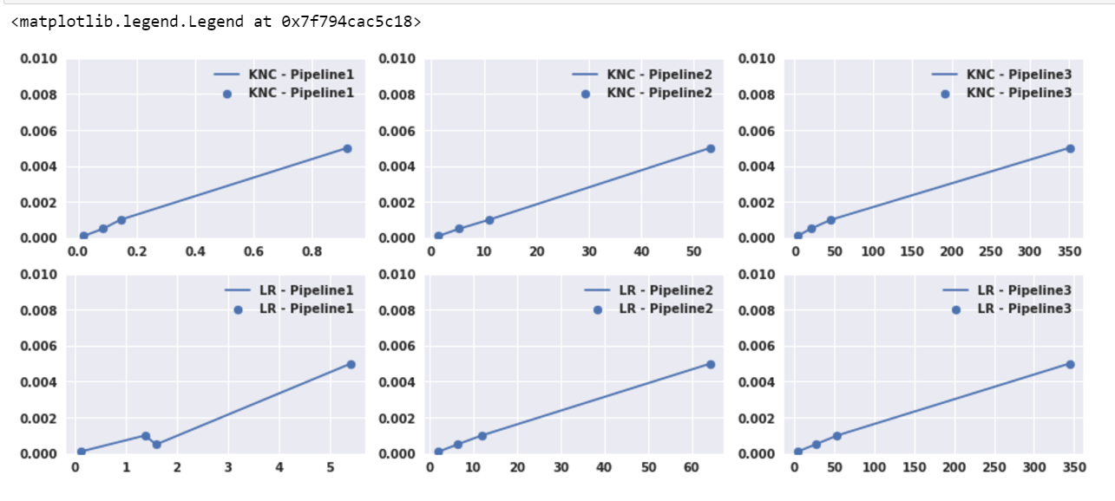
Procedure 2 evaluate each pipeline – fit time

Slide 12
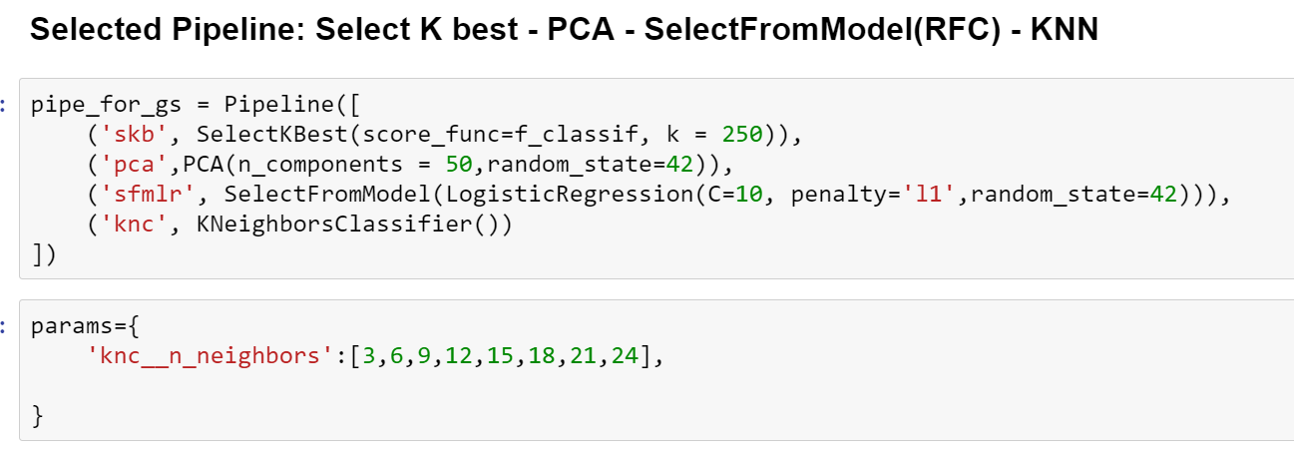
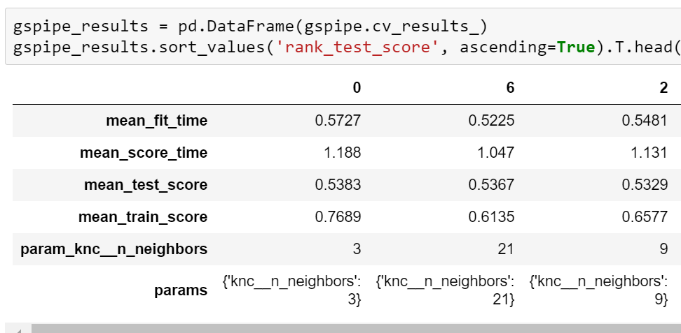
Procedure model tuning
ran with subset of
5% of the data
Notes:
Sfm_lasso

Slide 13
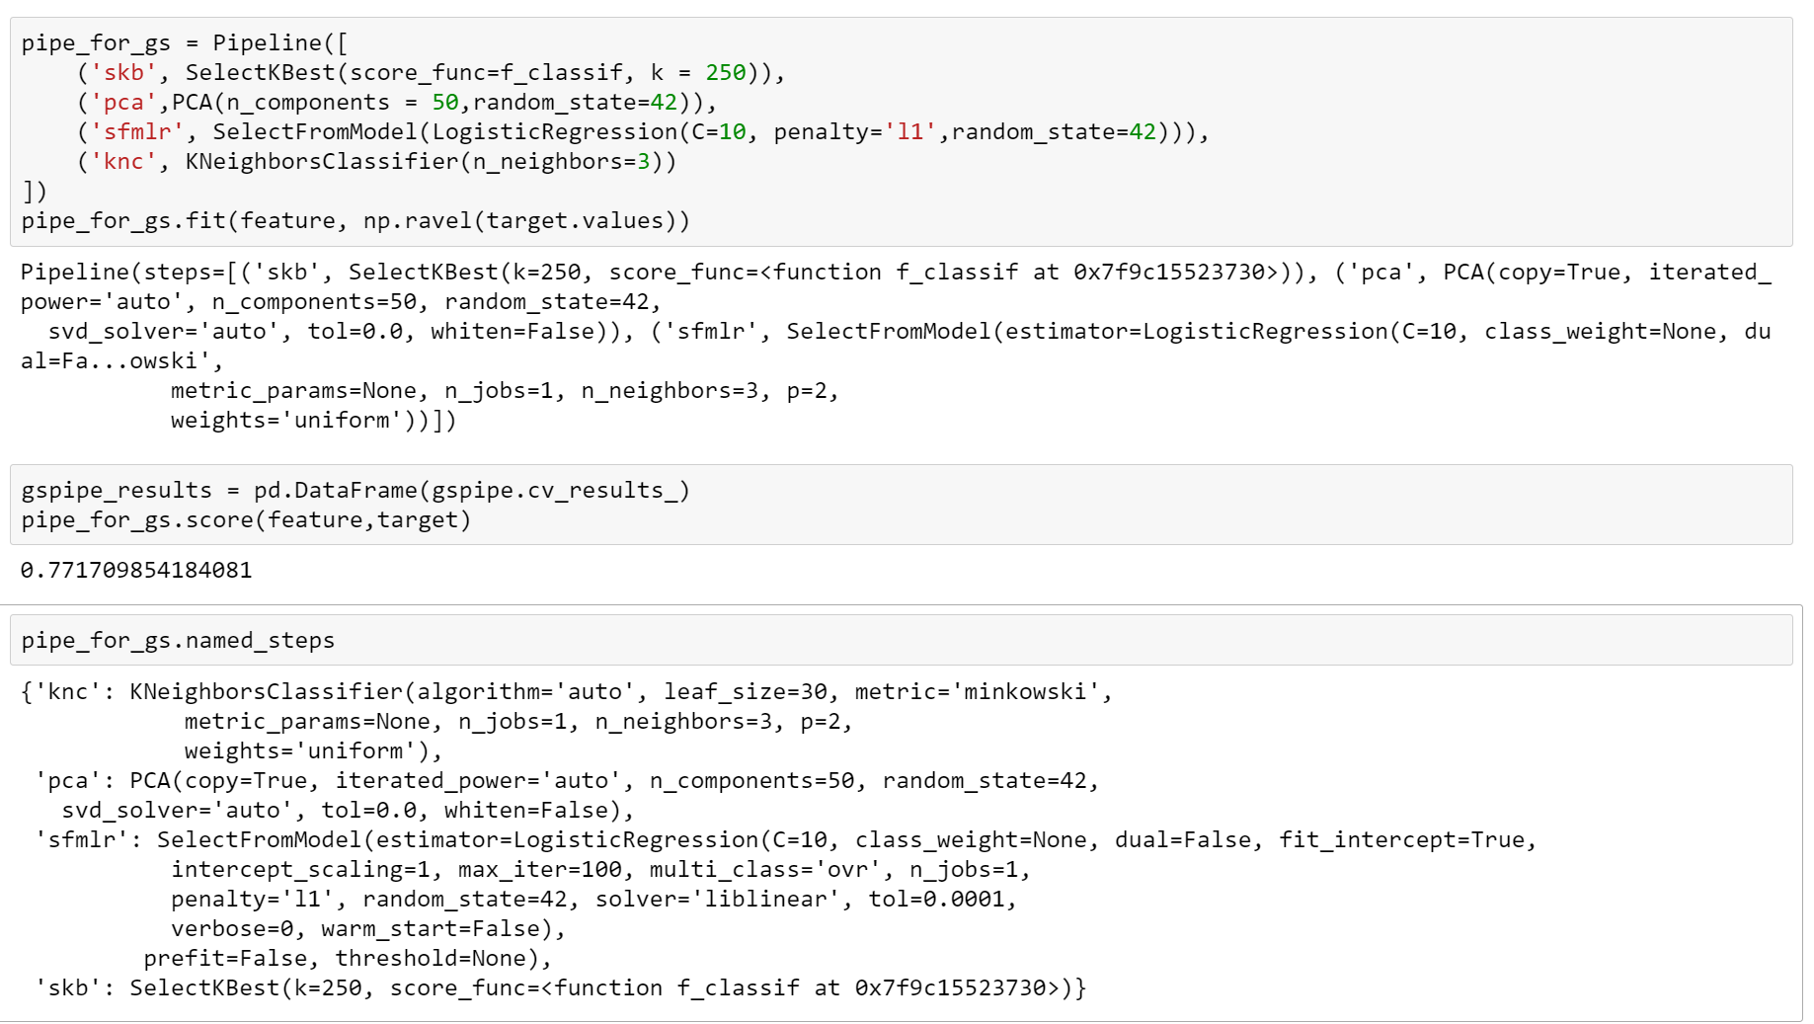
Final model
Data
SKM (ANOVA)
Select top 1000 Featurest
SKM (ANOVA)
Select top 250 Featurest
PCA 50 Components
SFM Logistic Regression
K Neighbor
Classifier
Final Score: 0.7717
(w/o train test split)
Data subset: 10767 rows

Slide 14
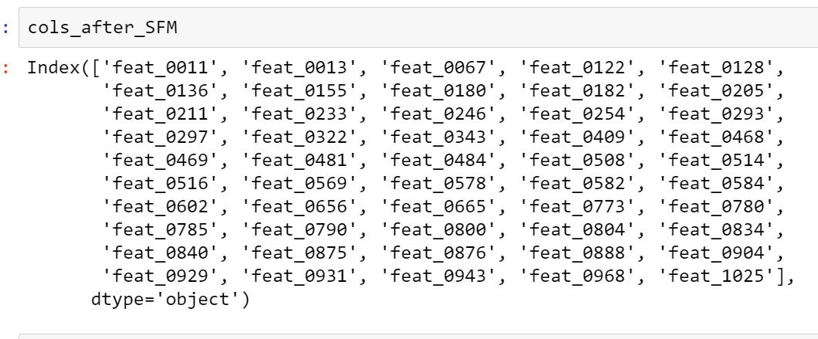
Final columns

Slide 15
Project learned
Usage of “Execute Preprocessor” to automate jupyter notebook run process
Process stored in: _Helper_Batch_Run.ipynb
The processing is repeatable and reliable
Pickle each Data subset, transformers and model results

Slide 16
Further study
Re-run the process on the 673 / 113 features which with p_value 1 / 2 standard deviation below the mean from the first ANOVA transformer
Pull at least 10% data to run through each pipeline and discard all the smaller subsets
Apply 100% data Grid Search on the final model

